Slide 1
Analysis of Employee Attrition Problem

Slide 2
Reasons why employees are prone to leaving the organization
Low satisfaction level which means the employees are not satisfied or comfortable with the job
Lack of promotion
Low salary and Medium salary
Employees involved in work accident

Slide 3
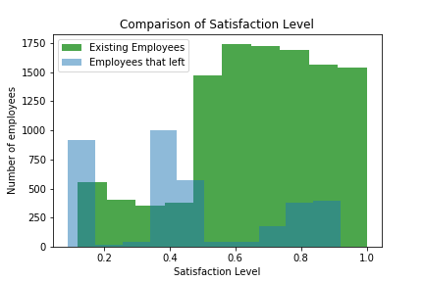
We can deduce from the graph below that employees that left have a lower satisfaction level. Most employees that left have a satisfaction level less than 0.5

Slide 4
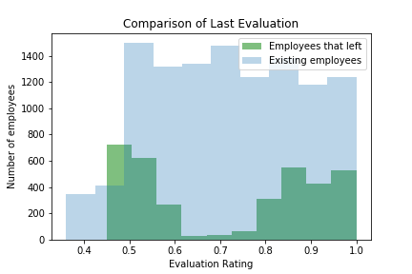
The graph below shows the Last Evaluation of the employees

Slide 5
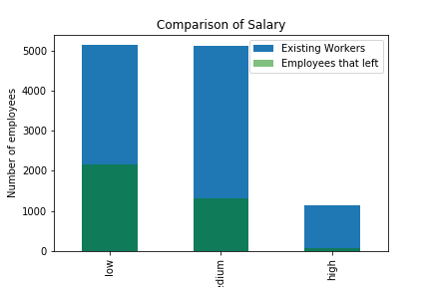
From the graph below we can see that majority of the people that left were paid low salary

Slide 6
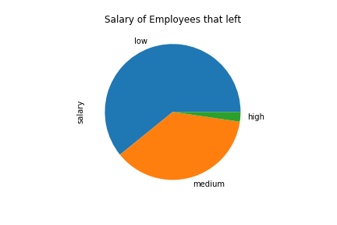
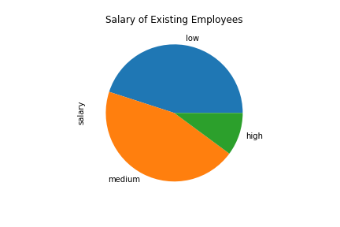
This graph also shows that a high percentage of those that left were paid low salaries

Slide 7
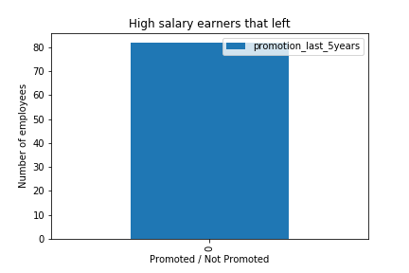
This graph shows that all the high salary earners that left the company were not promoted in the last five years

Slide 8
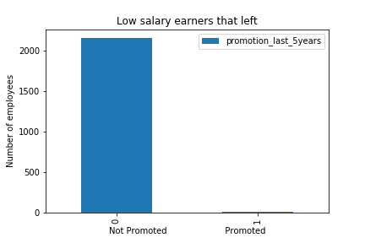
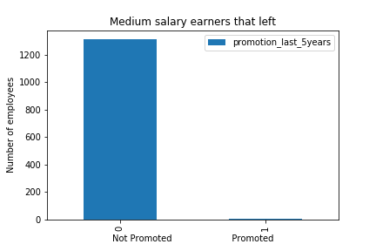
Also majority of those that left were not promoted in the last five years

Slide 9
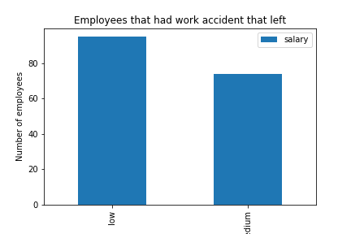
Based on the graph below, the employees that left were low and medium paid employees that had accident. Therefore it is more unlikely that a high paid employee would have accident.

Slide 10
Conclusion
The employees who would tend to leave are those who
Have not been promoted for the last five years
Are paid low and medium salaries and who have been involved in a work accident
Have low satisfaction level

